Slide 1
Configuration Model Properties Giant Component
MA 653: Network Science
Instructor: Ashok Singh Sairam
ashok@iitg.ac.in

Slide 2
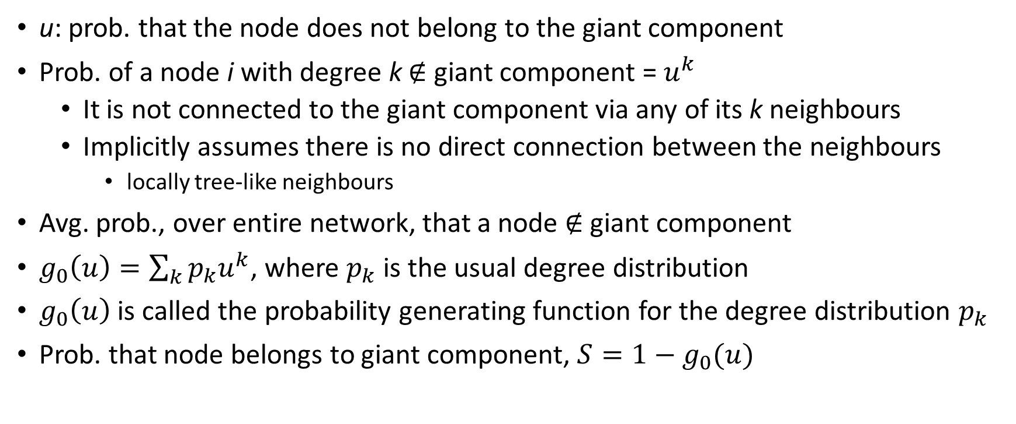
Giant component
u: prob. that the node does not belong to the giant component
Prob. of a node i with degree k $∉$ giant component = $u^{k}$
It is not connected to the giant component via any of its k neighbours
Implicitly assumes there is no direct connection between the neighbours
locally tree-like neighbours
Avg. prob., over entire network, that a node $∉$ giant component
$g_{0}\left(u\right)=\sum_{k}{p_{k}u^{k}}$, where $p_{k}$ is the usual degree distribution
$g_{0}\left(u\right)$ is called the probability generating function for the degree distribution $p_{k}$
Prob. that node belongs to giant component, $S=1−g_{0}(u)$

Slide 3
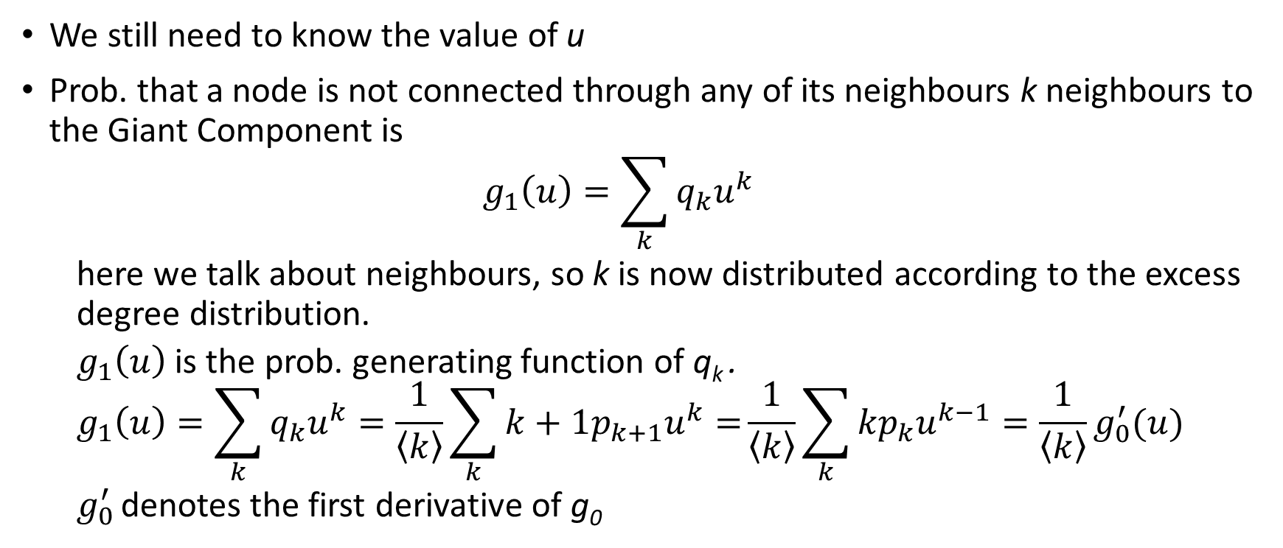
We still need to know the value of u
Prob. that a node is not connected through any of its neighbours k neighbours to the Giant Component is
$$g_{1}\left(u\right)=\sum_{k}{q_{k}u^{k}}$$
here we talk about neighbours, so k is now distributed according to the excess degree distribution.
$g_{1}\left(u\right)$ is the prob. generating function of q_{k} .
$$g_{1}\left(u\right)=\sum_{k}{q_{k}u^{k}}=\frac{1}{\left\langle k\right\rangle }\sum_{k}{{k+1p}_{k+1}u^{k}=}\frac{1}{\left\langle k\right\rangle }\sum_{k}{{kp}_{k}u^{k−1}=\frac{1}{\left\langle k\right\rangle }g_{0}^{′}(u)}$$
$g_{0}^{′}$ denotes the first derivative of g₀

Slide 4
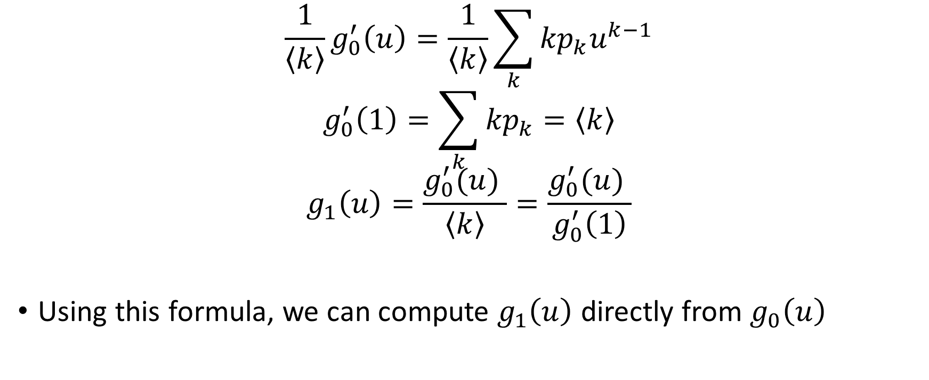
$$\frac{1}{\left\langle k\right\rangle }g_{0}^{′}\left(u\right)=\frac{1}{\left\langle k\right\rangle }\sum_{k}{{kp}_{k}u^{k−1}}$$
$$g_{0}^{′}\left(1\right)=\sum_{k}{{kp}_{k}}=\left\langle k\right\rangle$$
$$g_{1}\left(u\right)=\frac{g_{0}^{′}(u) }{\left\langle k\right\rangle }=\frac{g_{0}^{′}(u) }{g_{0}^{′}\left(1\right)}$$
Using this formula, we can compute $g_{1}\left(u\right)$ directly from $g_{0}\left(u\right)$

Slide 5
Example: Giant component
Consider a network that has nodes only of degree 0, 1, 2 and 3
If we use the configuration model, does the network have a giant component? Compute the value of S.

Slide 6
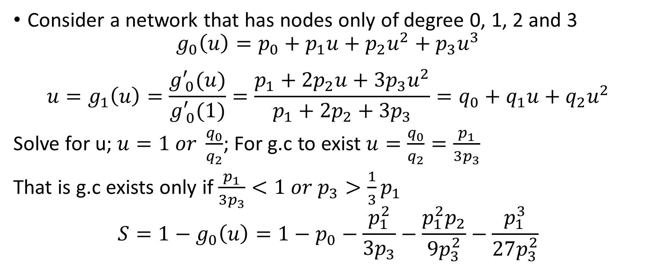
Example: Giant component
Consider a network that has nodes only of degree 0, 1, 2 and 3
$$g_{0}\left(u\right)=p_{0}+p_{1}u+p_{2}u^{2}+p_{3}u^{3}$$
$$u=g_{1}\left(u\right)=\frac{g_{ 0}^{′}(u)}{g_{ 0}^{′}(1)}=\frac{p_{1}+{2p}_{2}u+{3p}_{3}u^{2}}{p_{1}+{2p}_{2}+{3p}_{3}}=q_{0}+q_{1}u+q_{2}u^{2}$$
Solve for u; $u=1 or \frac{q_{0}}{q_{2}}$; For g.c to exist $u=\frac{q_{0}}{q_{2}}=\frac{p_{1}}{3p_{3}}$
That is g.c exists only if $\frac{p_{1}}{3p_{3}}<1 or p_{3}>\frac{1}{3}p_{1}$
$$S=1−g_{0}\left(u\right)=1−p_{0}−\frac{p_{1}^{2}}{3p_{3}}−\frac{p_{1}^{2}p_{2}}{9p_{3}^{2}}−\frac{p_{1}^{3}}{27p_{3}^{2}}$$

Slide 7
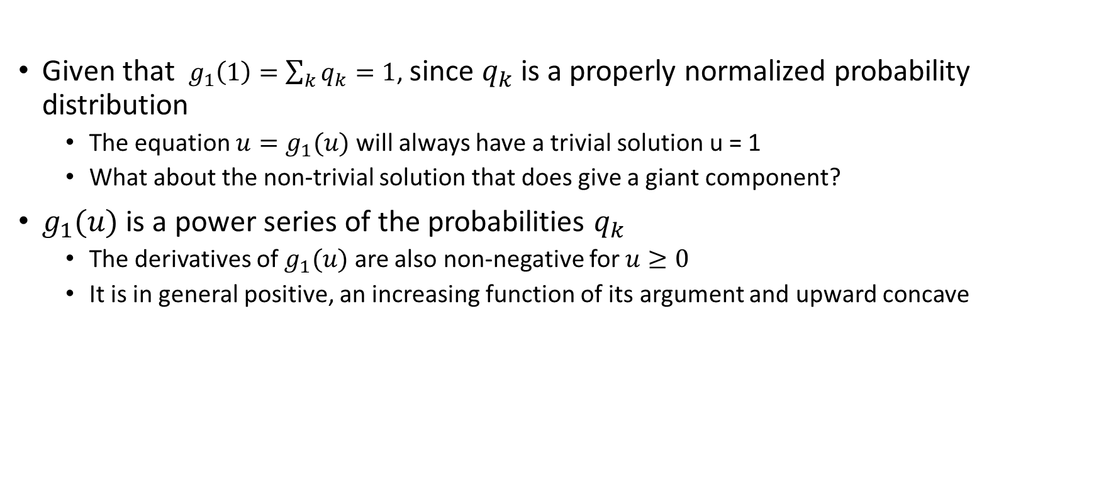
General solution for the size of giant component
Given that $g_{1}\left(1\right)=\sum_{k}{q_{k}=1}$, since $q_{k}$ is a properly normalized probability distribution
The equation $u=g_{1}(u)$ will always have a trivial solution u = 1
What about the non-trivial solution that does give a giant component?
$g_{1}(u)$ is a power series of the probabilities $q_{k}$
The derivatives of $g_{1}(u)$ are also non-negative for $u≥0$
It is in general positive, an increasing function of its argument and upward concave

Slide 8
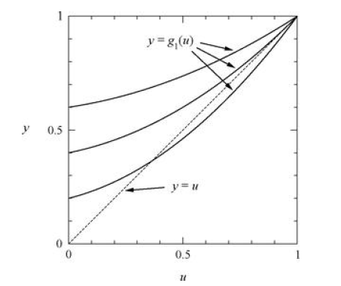
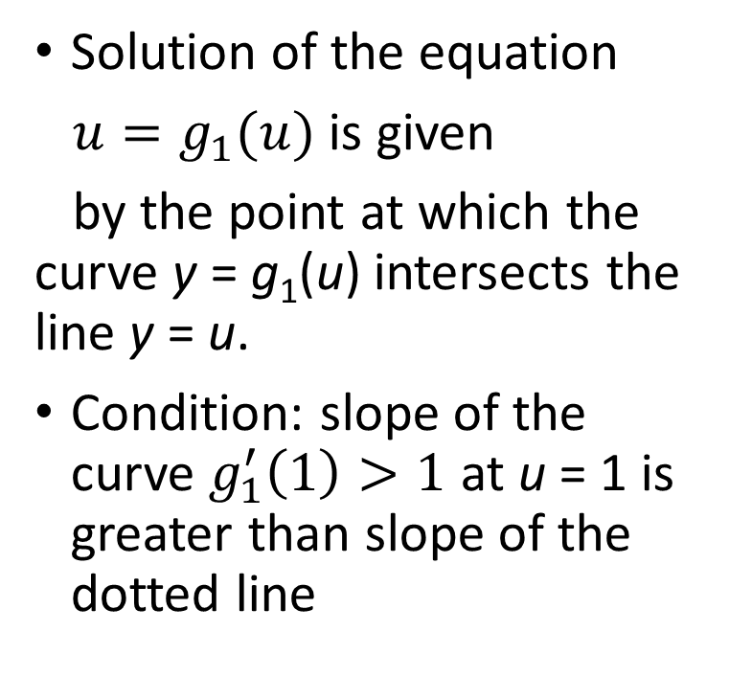
Solution of the equation
$u=g_{1}(u)$ is given
by the point at which the curve y = g₁(u) intersects the line y = u.
Condition: slope of the curve $g_{1}^{′}\left(1\right)>1$ at u = 1 is greater than slope of the dotted line

Slide 9
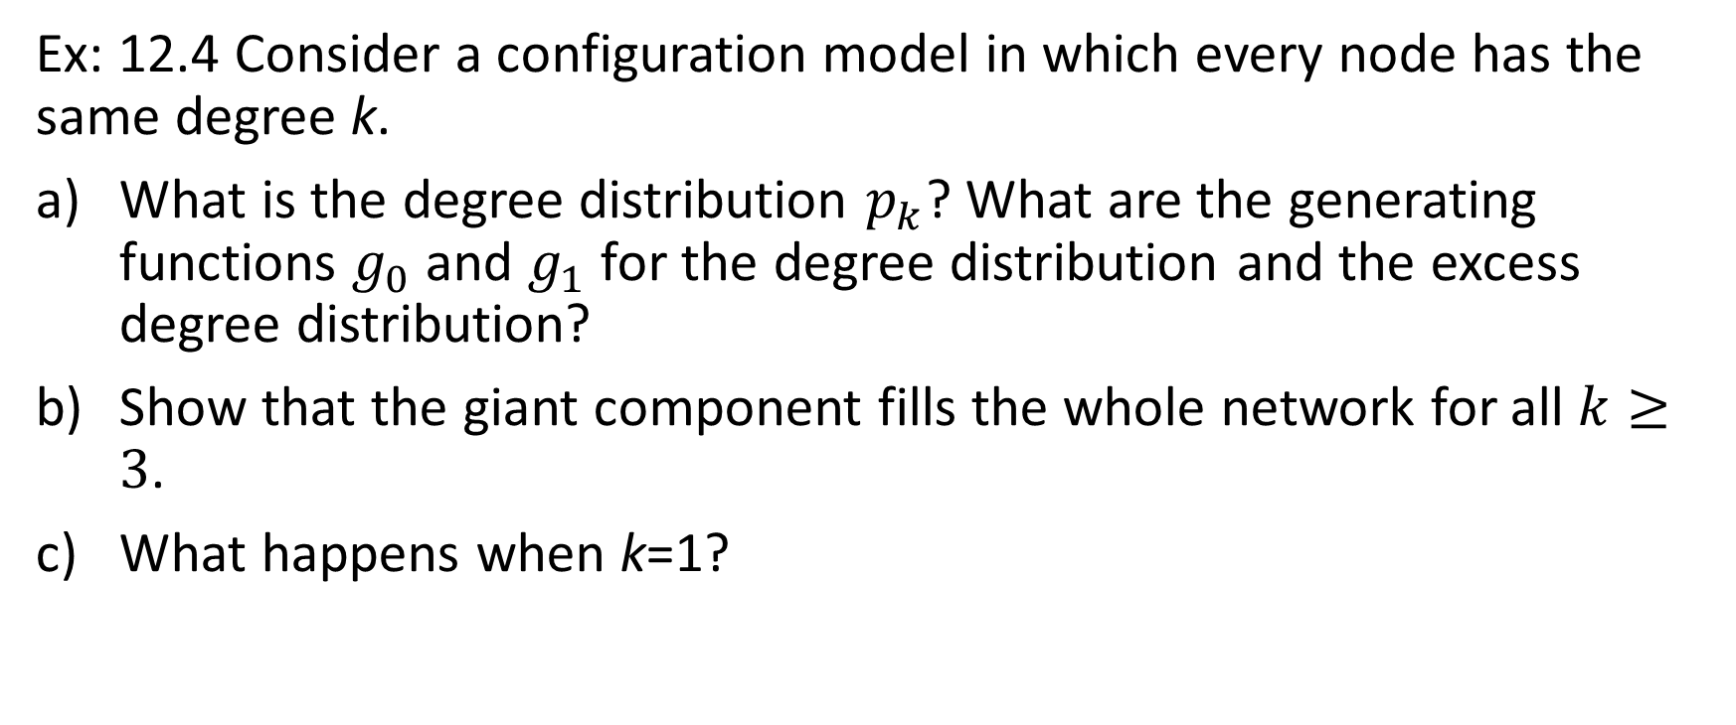
Review
Ex: 12.4 Consider a configuration model in which every node has the same degree k.
What is the degree distribution $p_{k}$? What are the generating functions $g_{0}$and $g_{1}$ for the degree distribution and the excess degree distribution?
Show that the giant component fills the whole network for all $k≥3$.
What happens when k=1?

Slide 10
Configuration Model Properties Small Component
MA 653: Network Science
Instructor: Ashok Singh Sairam
ashok@iitg.ac.in

Slide 11
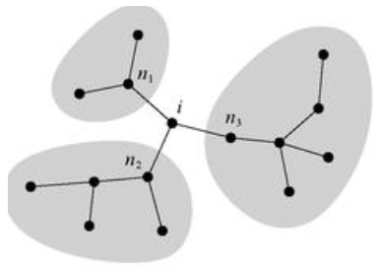
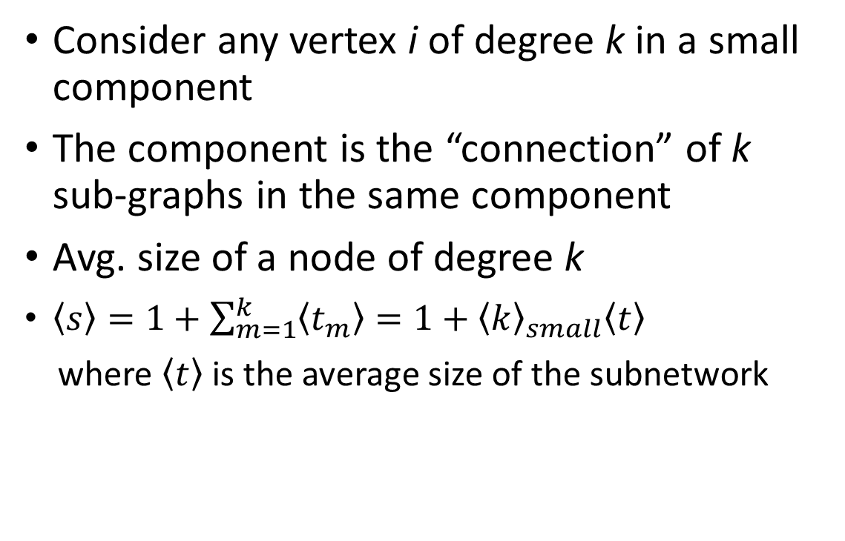
Size of a small component
Consider any vertex i of degree k in a small component
The component is the “connection” of k sub-graphs in the same component
Avg. size of a node of degree k
$\left\langle s\right\rangle =1+\sum_{m=1}^{k}{\left\langle t_{m}\right\rangle }=1+{\left\langle k\right\rangle }_{small}\left\langle t\right\rangle$
where $\left\langle t\right\rangle$ is the average size of the subnetwork

Slide 12
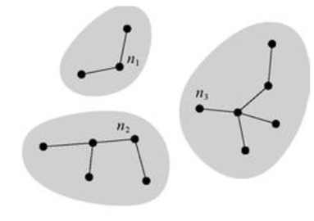
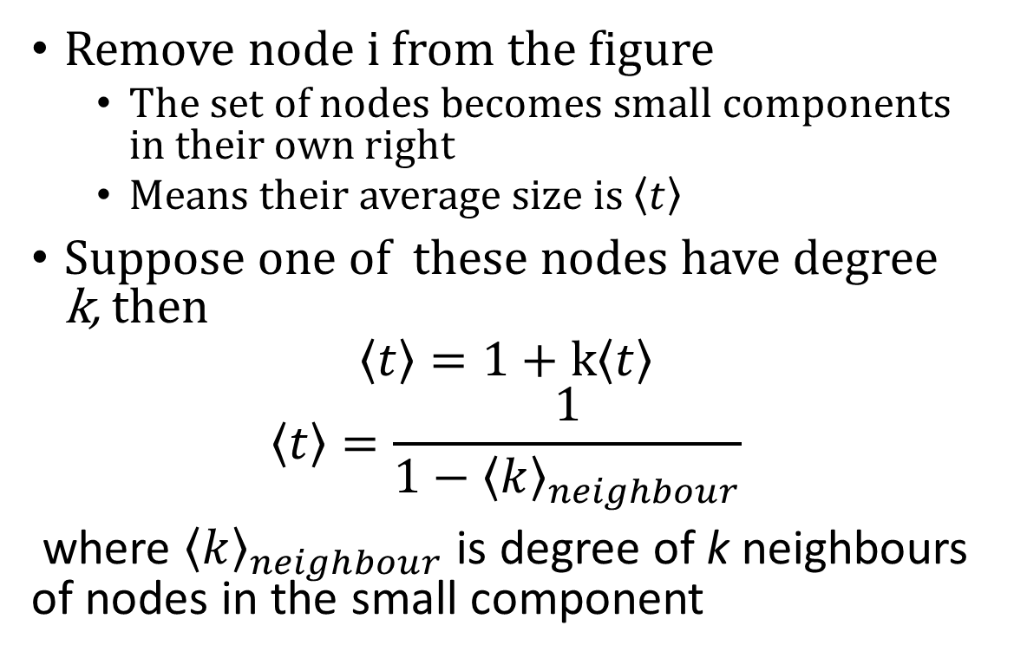
Small component
Remove node i from the figure
The set of nodes becomes small components in their own right
Means their average size is $\left\langle t\right\rangle$
Suppose one of these nodes have degree k, then
$$\left\langle t\right\rangle =1+k\left\langle t\right\rangle$$
$$\left\langle t\right\rangle =\frac{1}{1−{\left\langle k\right\rangle }_{neighbour}}$$
where ${\left\langle k\right\rangle }_{neighbour}$is degree of k neighbours of nodes in the small component

Slide 13
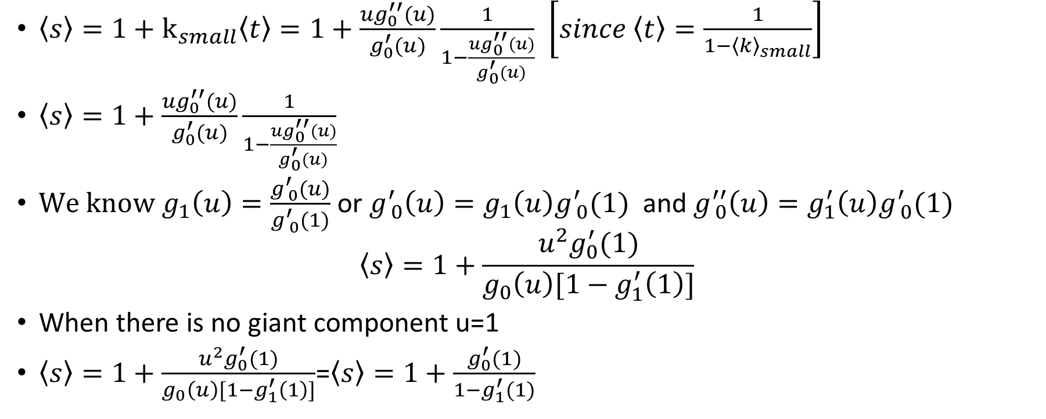
Average size of small component
$\left\langle s\right\rangle =1+k_{small}\left\langle t\right\rangle =1+\frac{ug_{0}^{′′}(u)}{g_{0}^{′}(u)}\frac{1}{1−\frac{ug_{0}^{′′}(u)}{g_{0}^{′}(u)}}$ $\left[since \left\langle t\right\rangle =\frac{1}{1−{\left\langle k\right\rangle }_{small}}\right]$
$\left\langle s\right\rangle =1+\frac{ug_{0}^{′′}(u)}{g_{0}^{′}(u)}\frac{1}{1−\frac{ug_{0}^{′′}(u)}{g_{0}^{′}(u)}}$
${We know g}_{1}\left(u\right)=\frac{g_{ 0}^{′}(u)}{g_{ 0}^{′}(1)}$ or $g_{ 0}^{′}\left(u\right)=g_{1}\left(u\right)g_{ 0}^{′}(1)$ and $g_{ 0}^{′′}\left(u\right)=g_{1}^{′}\left(u\right)g_{ 0}^{′}(1)$
$$\left\langle s\right\rangle =1+\frac{u^{2}g_{0}^{′}(1)}{g_{0}\left(u\right)[1−g_{1}^{′}\left(1\right)]}$$
When there is no giant component u=1
$\left\langle s\right\rangle =1+\frac{u^{2}g_{0}^{′}(1)}{g_{0}\left(u\right)[1−g_{1}^{′}\left(1\right)]}$=$\left\langle s\right\rangle =1+\frac{g_{0}^{′}(1)}{1−g_{1}^{′}(1)}$

Slide 14
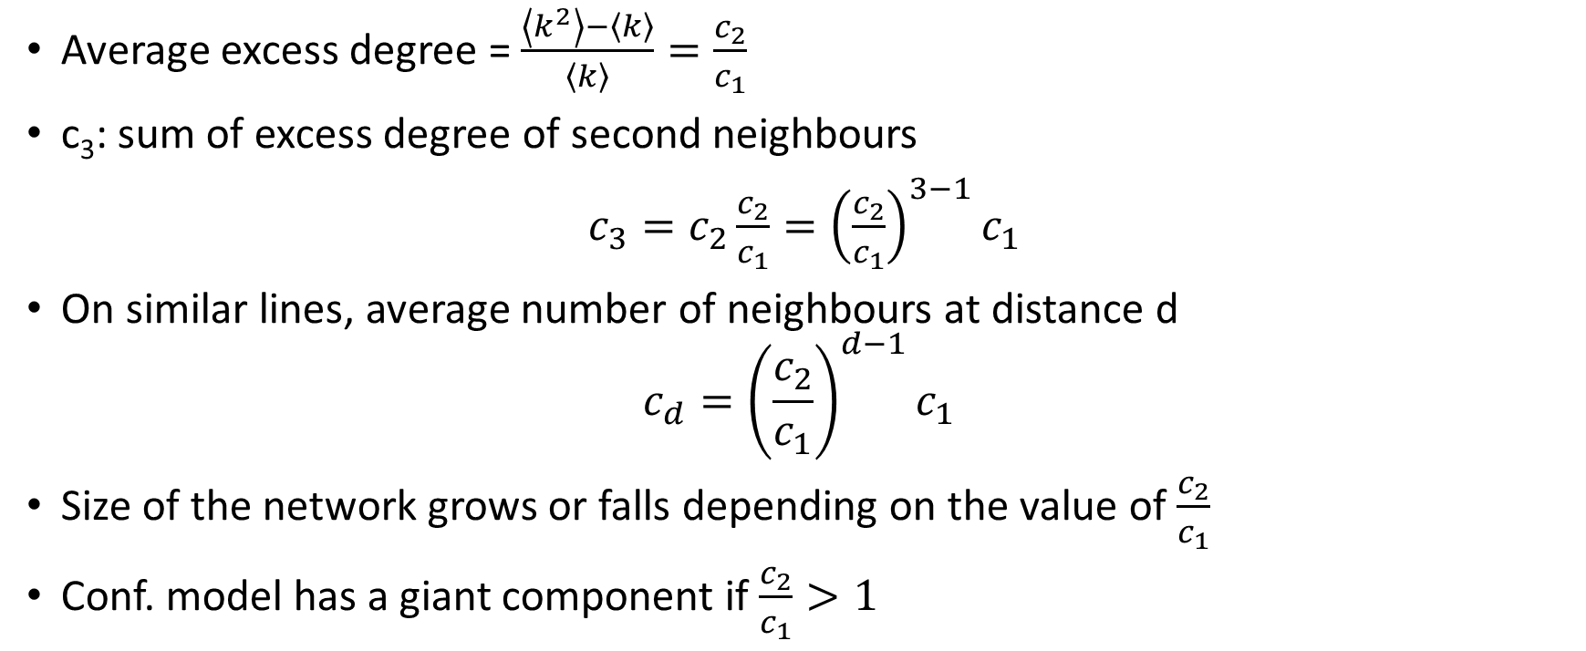
Review
Average excess degree = $\frac{\left\langle k^{2}\right\rangle −\left\langle k\right\rangle }{\left\langle k\right\rangle }=\frac{c_{2}}{c_{1}}$
c₃: sum of excess degree of second neighbours
$c_{3}=c_{2}\frac{c_{2}}{c_{1}}={\left(\frac{c_{2}}{c_{1}}\right)}^{3−1}c_{1}$
On similar lines, average number of neighbours at distance d
$$c_{d}={\left(\frac{c_{2}}{c_{1}}\right)}^{d−1}c_{1}$$
Size of the network grows or falls depending on the value of $\frac{c_{2}}{c_{1}}$
Conf. model has a giant component if $\frac{c_{2}}{c_{1}}>1$

Slide 15
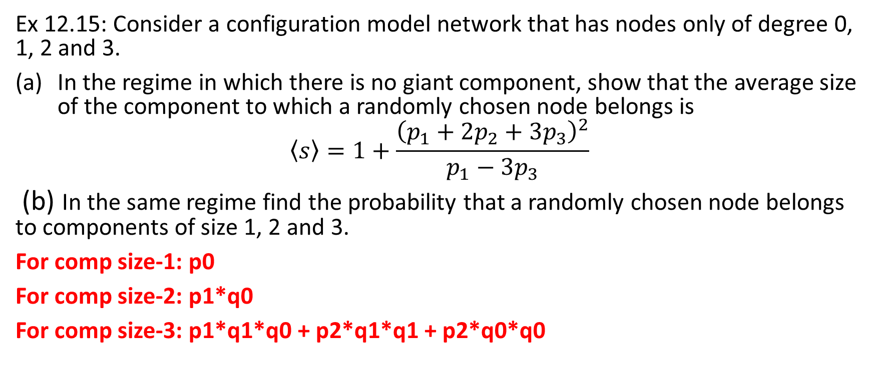
Exercise
Ex 12.15: Consider a configuration model network that has nodes only of degree 0, 1, 2 and 3.
In the regime in which there is no giant component, show that the average size of the component to which a randomly chosen node belongs is
$$\left\langle s\right\rangle =1+\frac{{\left(p_{1}+2p_{2}+3p_{3}\right)}^{2}}{p_{1}−3p_{3}}$$
(b) In the same regime find the probability that a randomly chosen node belongs to components of size 1, 2 and 3.
For comp size-1: p0
For comp size-2: p1*q0
For comp size-3: p1*q1*q0 + p2*q1*q1 + p2*q0*q0

Slide 16

Example
Consider a network with 100 nodes. The degree distribution of the network is $p_{k}=Ck^{−2.5}$. Find the degrees of the first 10 nodes.

Slide 17
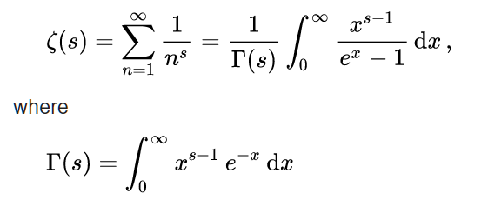
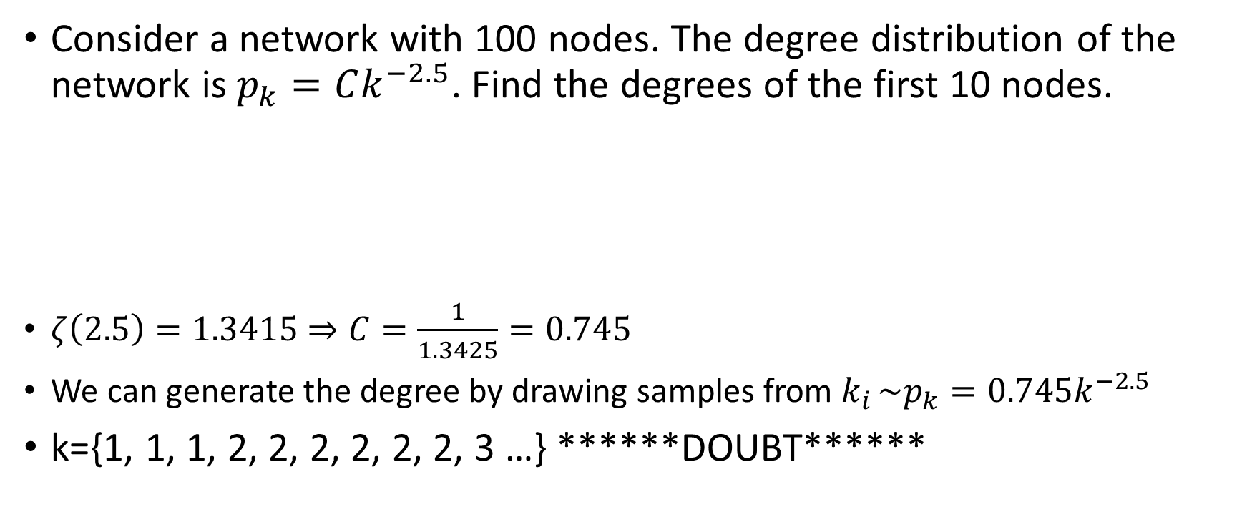
Example
Consider a network with 100 nodes. The degree distribution of the network is $p_{k}=Ck^{−2.5}$. Find the degrees of the first 10 nodes.
$ζ\left(2.5\right)=1.3415⇒C=\frac{1}{1.3425}=0.745$
We can generate the degree by drawing samples from ${k_{i }\sim p}_{k}=0.745k^{−2.5}$
k={1, 1, 1, 2, 2, 2, 2, 2, 2, 3 …} ******DOUBT******

